Slide 1
What’s New in Visual Studio for .NET developers
Junyu Wang, Simona Liao

Slide 2
Agenda
01
02
Editor + IDE
GitHub Copilot
03
04
Diagnostics
Git Version Control
All features are available in Visual Studio 17.12GA!

Slide 3
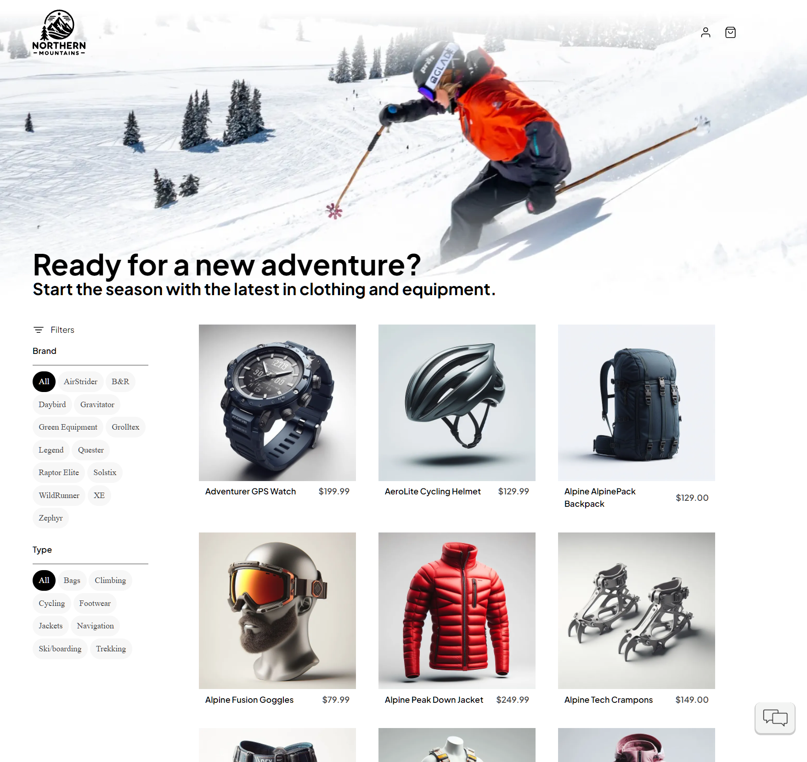
eShop
Framework: .NET 9, ASP.NET Core
Data Layer: Entity Framework Core, PostgreSQL
DevOps & Cloud: Docker, Kubernetes, Azure DevOps
Solution Structure Architecture:
Frontend: Web and mobile clients built with ASP.NET Core and Blazor
Backend: Multiple microservices managing different functionalities (Catalog, Ordering, Basket, etc.)

Slide 4
Review
All features are available in Visual Studio 17.12GA!
01
02
Editor + IDE
GitHub Copilot
Guided Chat, Function Calling, Model Picker
Better AI Completions for C#
Partial Accept (in upcoming releases!)
Code Search Scoping, Go to Line, Docking
Find in files refresh
Copy Error List, keyboard short cut
03
04
Diagnostics
Git Version Control
Customize AI Git commit message
Copy Git Link
Breakpoint Troubleshooting with Copilot
AI-Powered IEnumerable Visualizer
Breaks when an async Task method

Slide 5
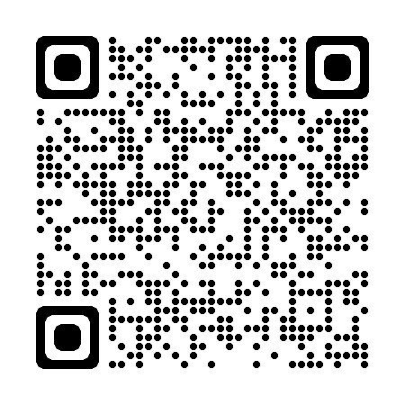
Tell us your feedback!
Help us to make even more community-driven improvements! ​
​
Start the conversation on Developer Community

Slide 6

Get .NET 9
Download .NET 9 aka.ms/get-dotnet-9

Slide 7
Upcoming Visual Studio Sessions
Discover the Latest GitHub Copilot Features for .NET Developers in Visual Studio
Rhea Patel
​
Nov 12
4:15 – 4:45 PM PST
​
Nov 13
6:30 – 7:00 PM PST
​
Master Visual Studio Debugging: Tips, Tricks, and AI Insights!
Harshada Hole
​

Slide 8
Thank you

Slide 13

Ensure slide content is accessible
CONTRAST
Use high contrast colors for maximum readability.
The recommended contrast ratio is at least 4.5:1.
SHAPE AND COLOR
Use different shapes with a legend to indicate statuses to accommodate for color blindness.
Example:
ALT TEXT
Alt text helps people with screen readers understand the content of slides.
You should create alternative text for shapes, pictures, charts, tables, SmartArt graphics, or other objects.
Here’s how:
Right click on item.
Select Edit Alt Text.
Enter a Description.
If an object is meant to add visual styling and doesn’t contain meaning (e.g., stylistic borders), do not add alt text and instead check “Mark as decorative.”
SLIDE LAYOUTS
Using a built-in slide layout that matches your content ensures a hierarchical reading order of text blocks.
Example:
If a new slide will have a title, rather than starting with a blank layout and adding a text block for the title, choose one of the built-in layouts with a title placeholder.
READING ORDER
Screen readers describe content on the screen in the order it was created.
To ensure your content is read back in the order you prefer, arrange your objects in the Selection Pane appropriately. Objects on the bottom of the selection pane are read first.
Here’s how:
Click the Home tab.
In the Drawing group, select the Arrange drop-down menu.
Click Selection Pane…
Subject 1
Color Contrast Analyzer
Download this tool to determine the legibility of text and the contrast of visual elements.
Subject 2
Subject 3
Download
C1
C2
C3
ADDITIONAL TIPS
Be sure to run the Accessibility Checker! Go to File click the Check for Issues drop down menu click Check Accessibility.
Videos need to be accessible: If your presentation includes a video, ensure it is captioned and audio described (if appropriate).
Visit the Office Accessibility Center to learn more about accessibility in PowerPoint.

